Slide 1
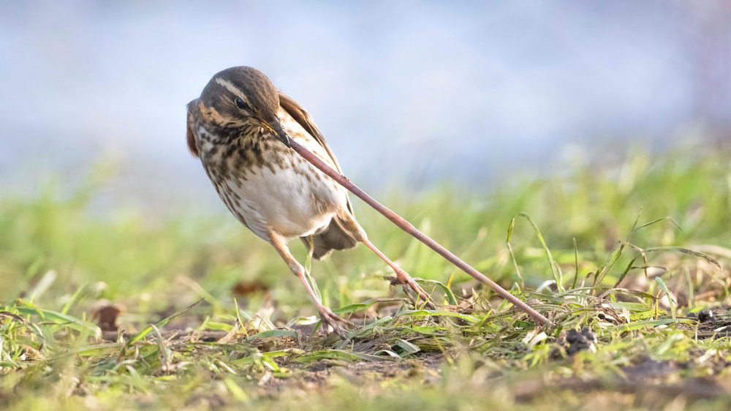
Redwing catching worm | (Berks, Bucks & Oxon Wildlife Trust) College Lake Nature Reserve, Tring, Buckinghamshire | by Roy McDonald

Slide 2
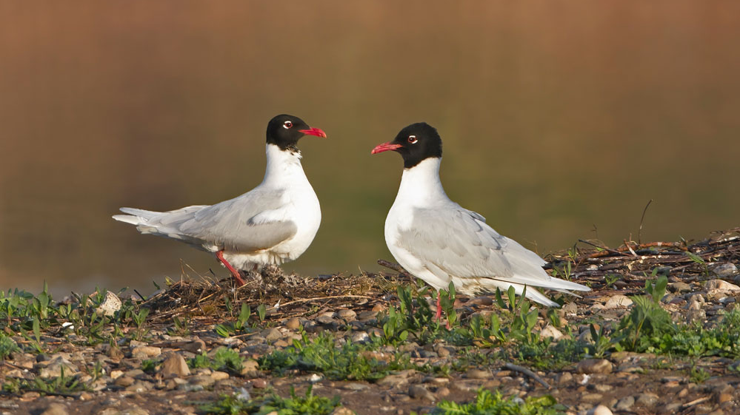
Pair of Mediterranean gulls with young | (RSPB) Wood Lane Nature Reserve, Ellesmere, Shropshire | by John Hawkins

Slide 3
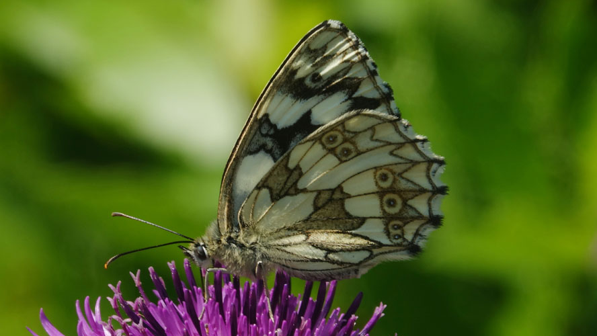
Marbled white butterfly feeding on Knapweed | (Berks, Bucks & Oxon Wildlife Trust) College Lake Nature Reserve, Tring, Buckinghamshire | by Graham Scott

Slide 4
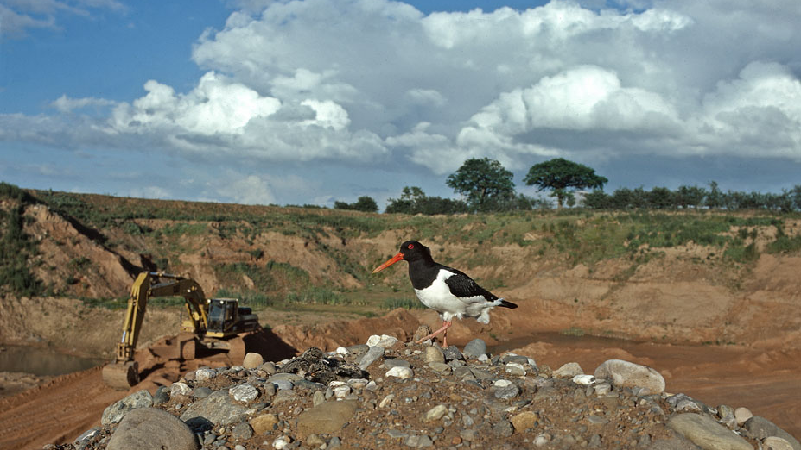
Oystercatcher with nest | Wood Lane Quarry, Ellesmere, Shropshire | by Stuart Lawrence

Slide 5
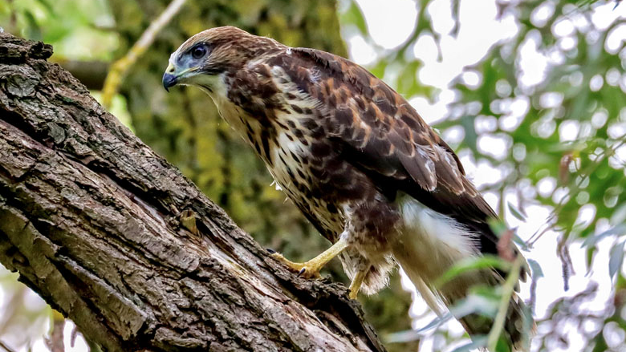
Juvenile common buzzard | Barham Quarry, Ipswich, Suffolk | by Ian Rumbellow

Slide 6
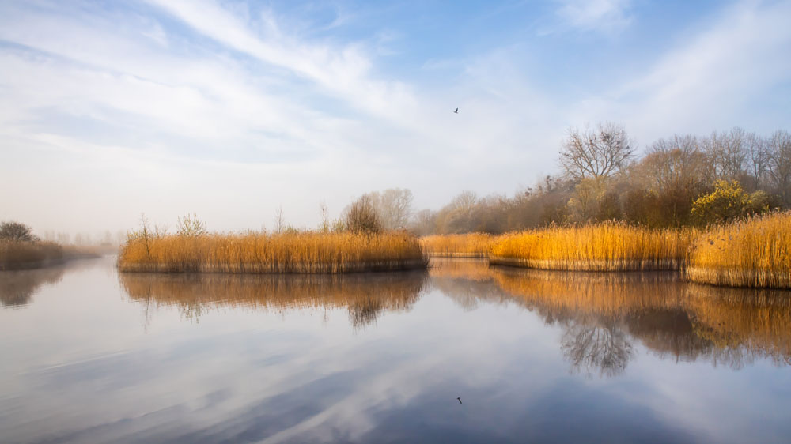
Slight mist rising off the water and showing the reedbeds in early morning light | (Cotswold Lakes Trust) Cleveland Lakes, Ashton Keynes, Wiltshire | by Jill Bewley

Slide 7
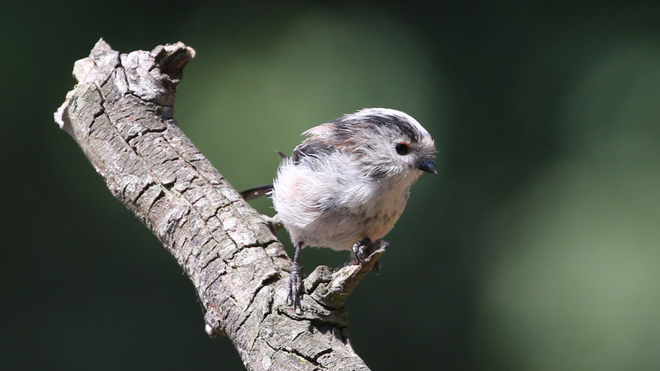
Long-tailed tit | Croft Quarry, Croft, Leicestershire | by Dick Jones

Slide 8
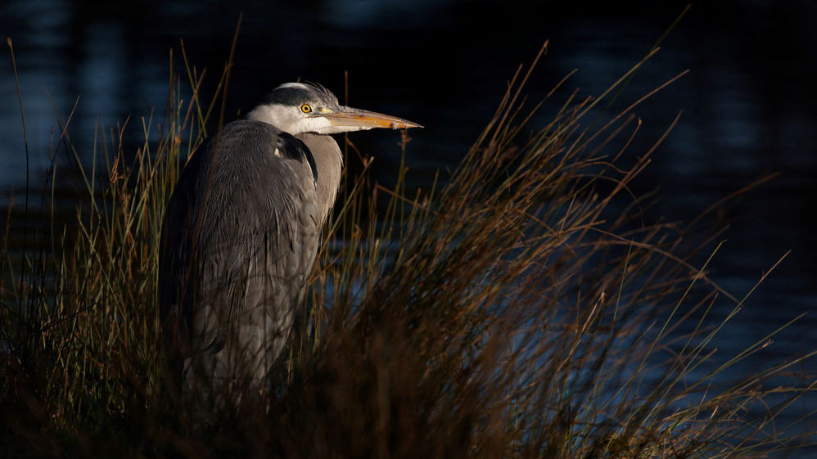
Grey heron catching the last few rays of the evening sun | (Leicestershire and Rutland Wildlife Trust) Cossington Meadows, Cossington, Leicester | by Mike Belson

Slide 9
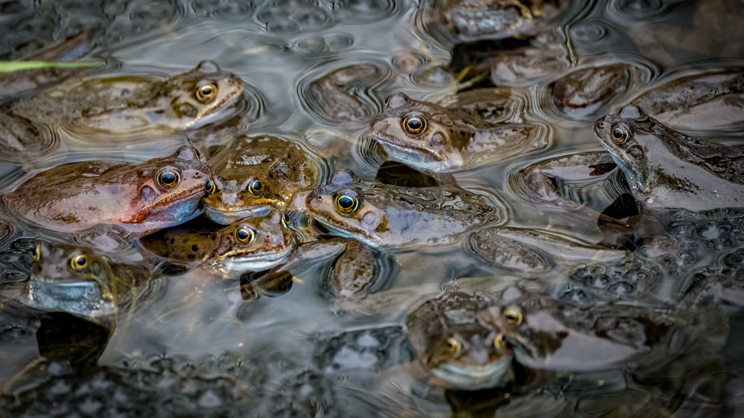
Common frogs spawning | Mullaghglass Quarry, County Antrim, Northern Ireland | by Paul Hilton

Slide 10
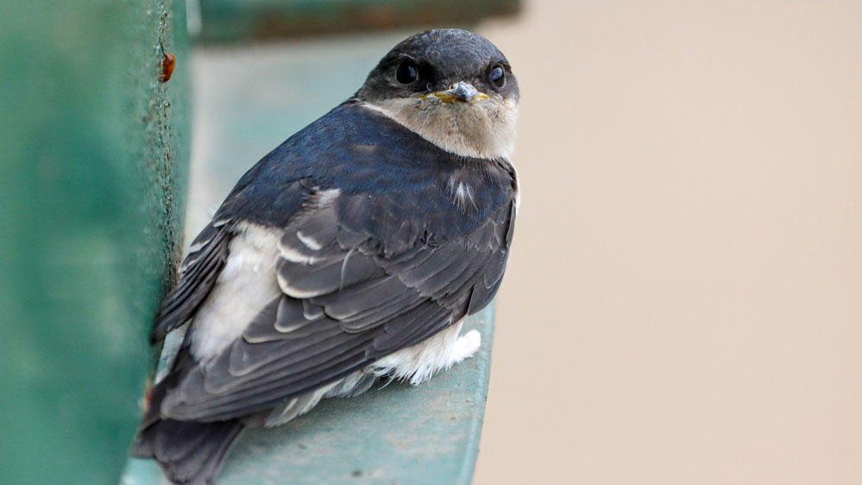
House martin | Howford Quarry, Hexham, Northumberland | by Chris Jordan

Slide 11
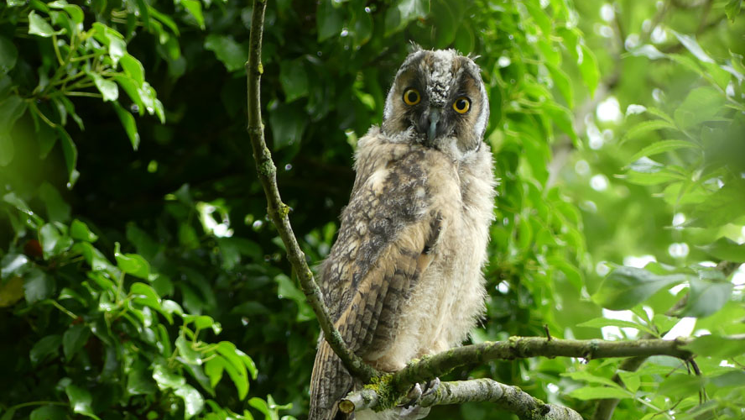
Young long eared owl | Kilroot Mine, Co. Antrim, Northern Ireland | by Linda Thompson

Slide 12
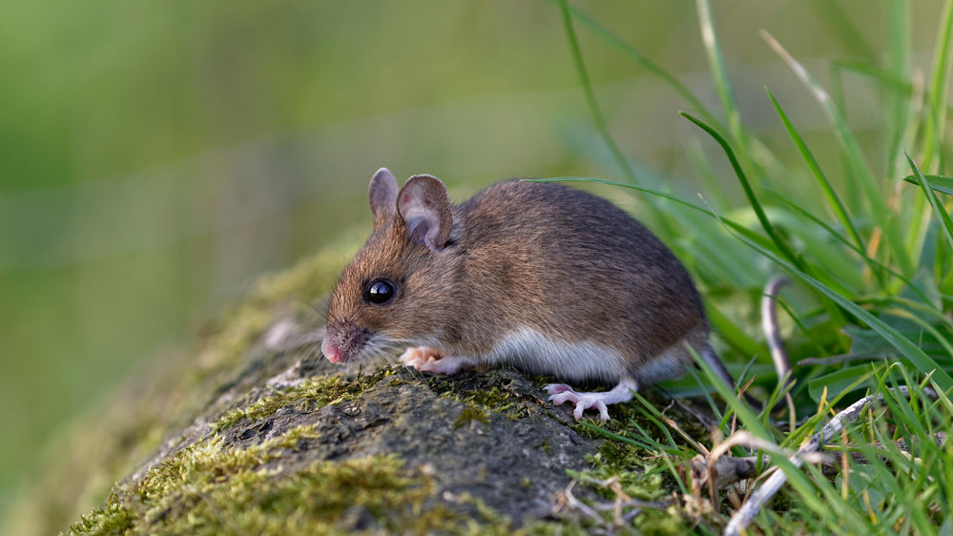
Wood mouse | Asham Quarry Wood, near Downhead, Somerset | by Shane Fry

Slide 13
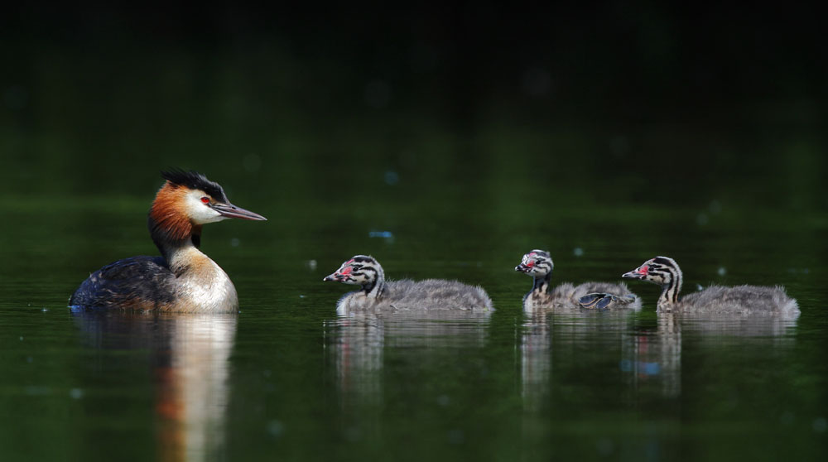
Great crested grebe family | Swillbrook Nature Reserve, Cirencester, Gloucestershire | by Dave Soons

Slide 14
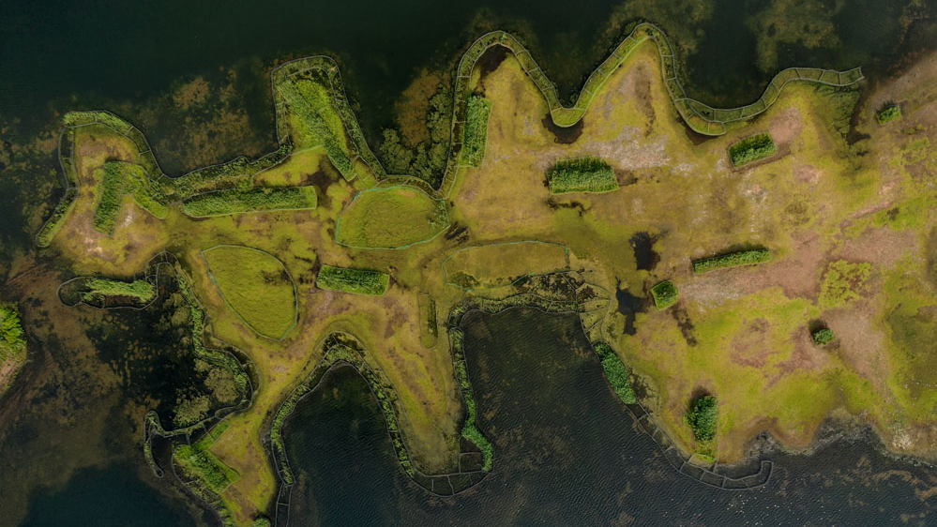
Drone over peninsula reedbeds | (RSPB) Langford Lowfields Nature Reserve, Newark, Nottinghamshire | by Jeremy Murfitt

Slide 15
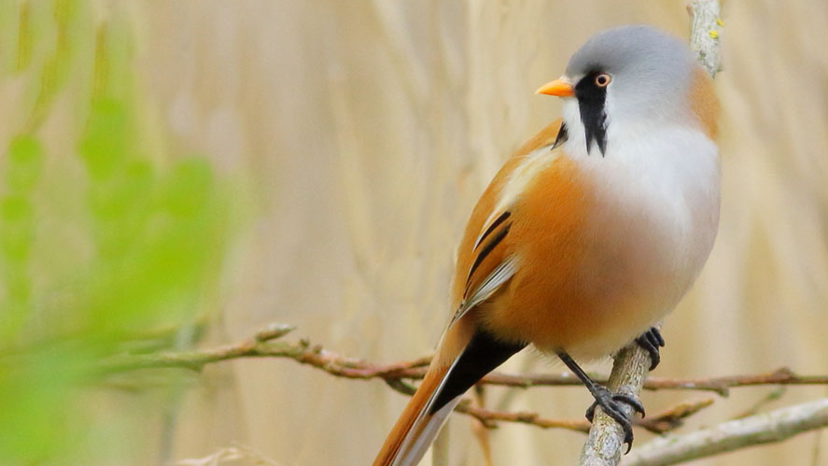
Male bearded tit | Kings Dyke Nature Reserve (Forterra), Kings Dyke, Whittlesey, Cambridgeshire | by Terry McKenna

Slide 16
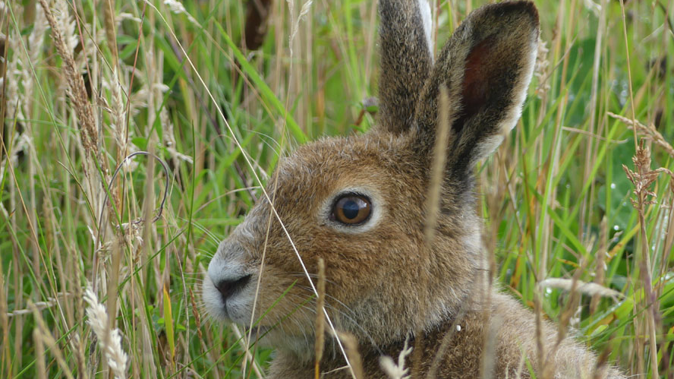
Irish hare | Undisclosed Northern Ireland Quarry | by Linda Thompson

Slide 17
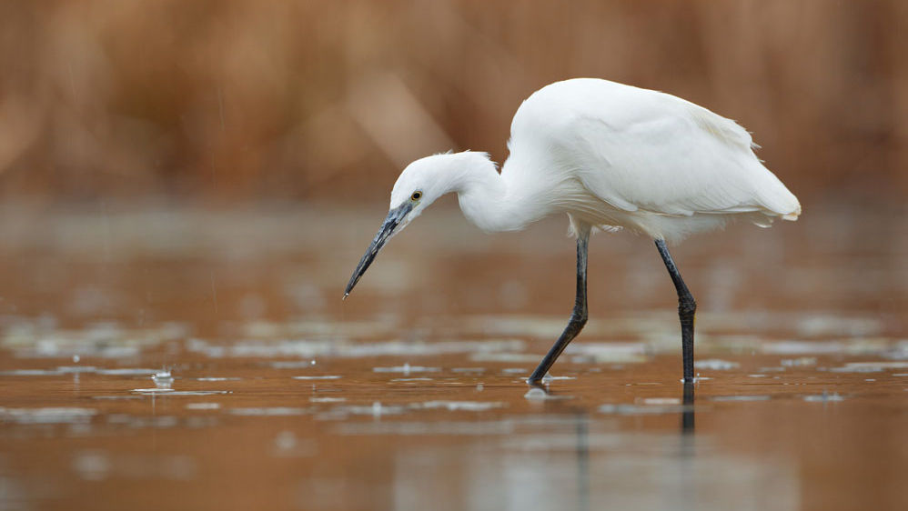
Little egret hunting in the rain | (Leicestershire and Rutland Wildlife Trust) Cossington Meadows, Cossington, Leicester | by Mike Belson

Slide 18
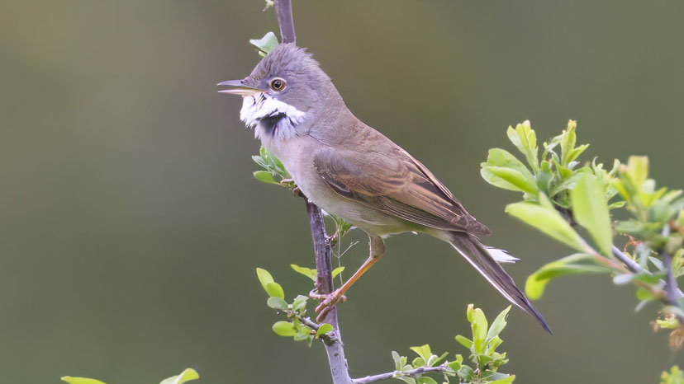
Male whitethroat declaring its territory | (RSPB) Langford Lowfields Nature Reserve, Newark, Nottinghamshire | by Stuart Carlton

Slide 19
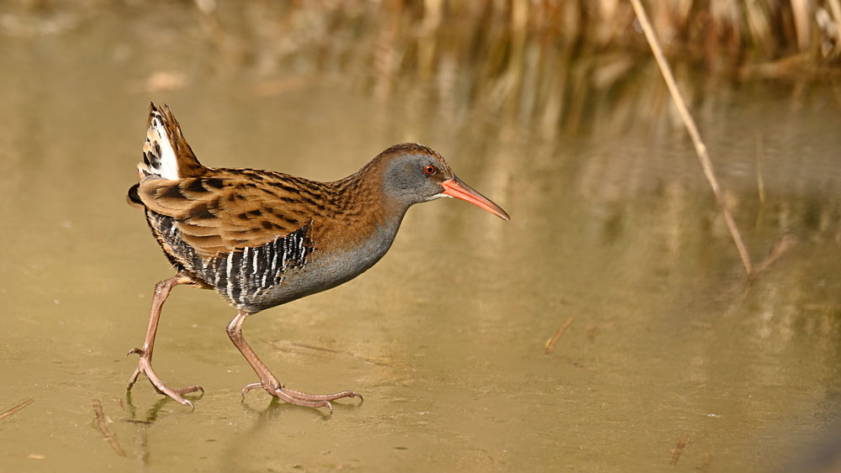
Water rail walking across a frozen channel through a reedbed | Kings Dyke Nature Reserve, Whittlesey, Cambridgeshire | by George Walthew

Slide 20
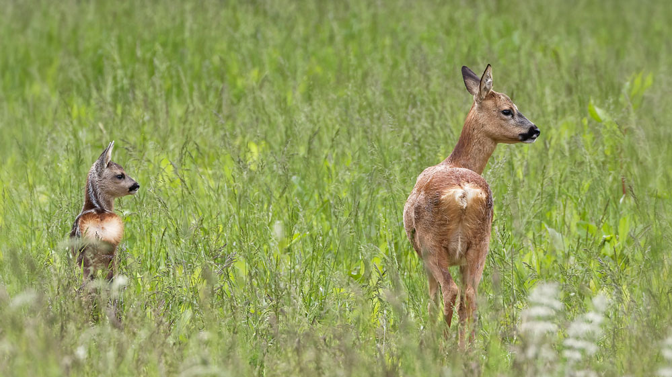
Roe deer and fawn | Asham Quarry Wood, near Downhead, Somerset | by Shane Fry

Slide 21
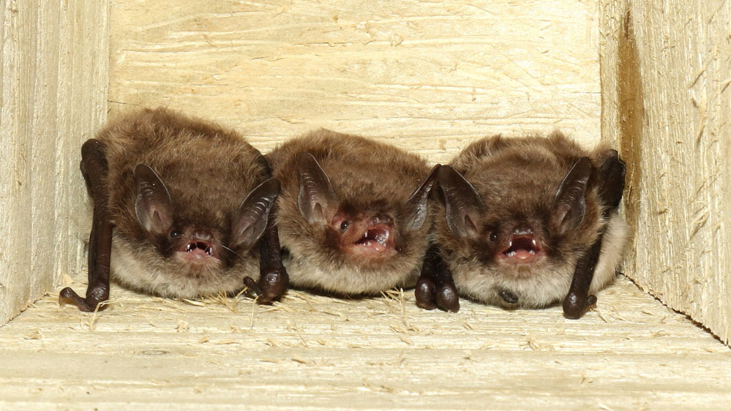
Daubenton's bats prior to evening emergence | (Devon Wildlife Trust) Sourton Quarry, Nr Okehampton, Devon | by John J Kaczanow

Slide 22
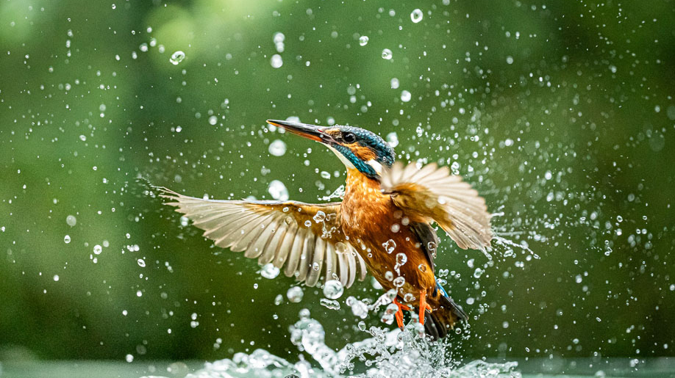
Kingfisher rising from below | Hereford Quarry, Hereford, Herefordshire | by Adrian Radnor

Slide 23
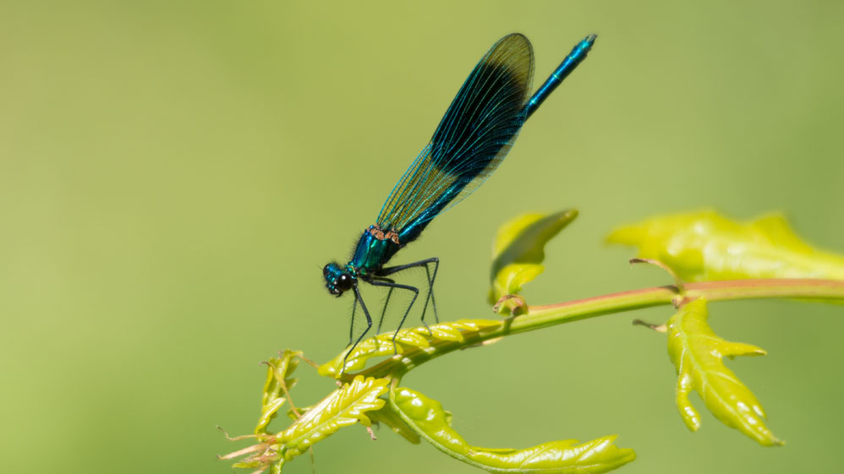
Banded demoiselle damselfly | Holborough Marshes, Snodland, Kent | by Stephen Weeks

Slide 24
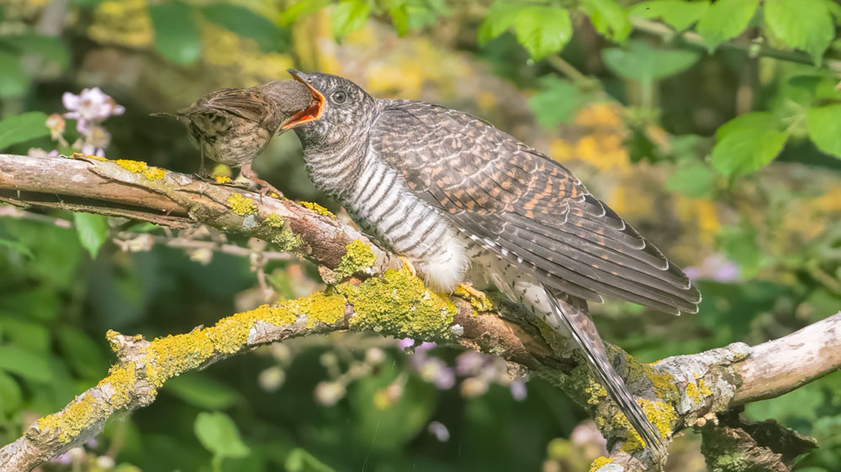
Juvenile cuckoo being fed | (RSPB) Fen Drayton Lakes, St Ives, Cambridgeshire | by Roy McDonald

Slide 25
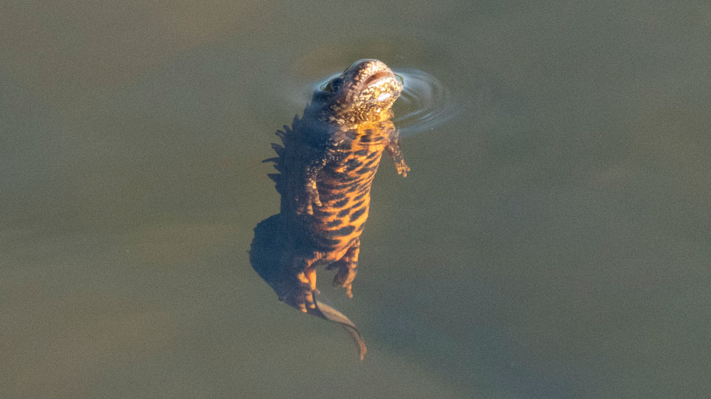
Great crested newt | (Yorkshire Wildlife Trust) North Cave Wetlands Nature Reserve, Market Weighton, East Riding of Yorkshire | by Helen Fernyhough

Slide 26
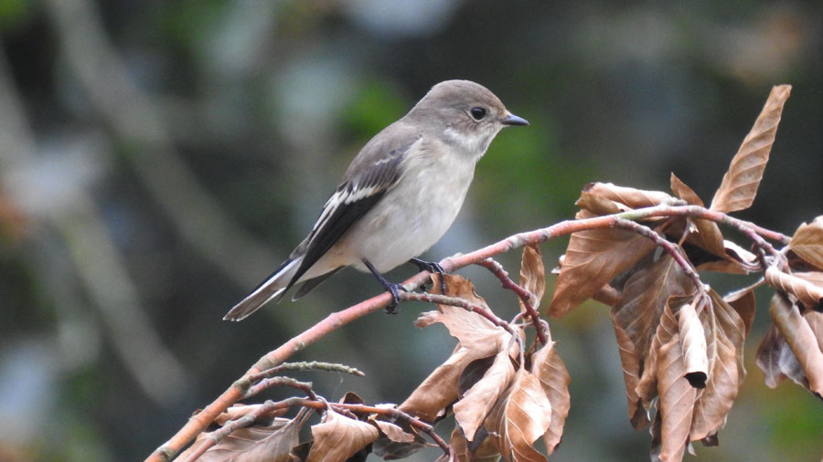
Pied flycatcher | Chard Junction Quarry Nature Reserve, Chard, Somerset | by Dave Helliar

Slide 27
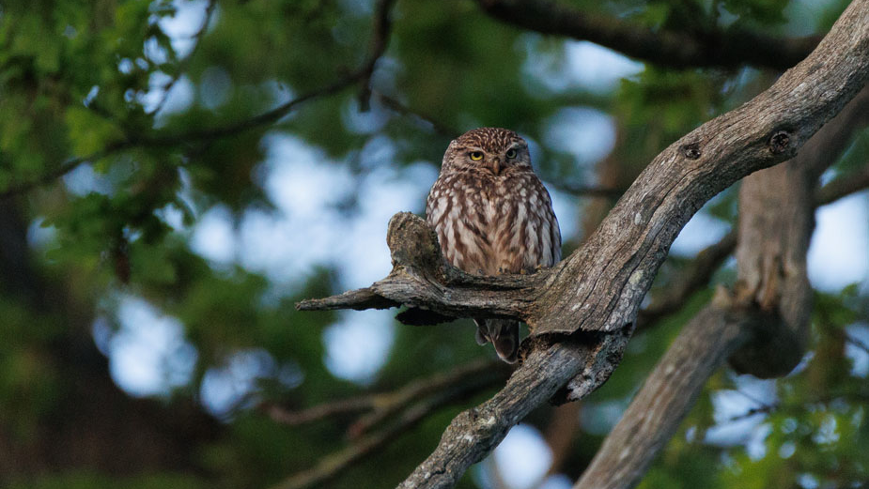
Little owl | Hereford Quarry, Hereford, Herefordshire | by Adrian Radnor

Slide 28
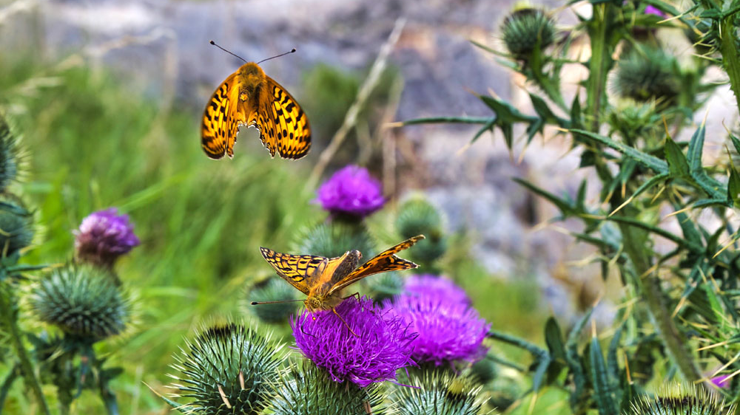
Dark green fritillary butterflies feeding on thistle | Arcow Quarry, Settle, North Yorkshire | by Michael Cardus

Slide 29
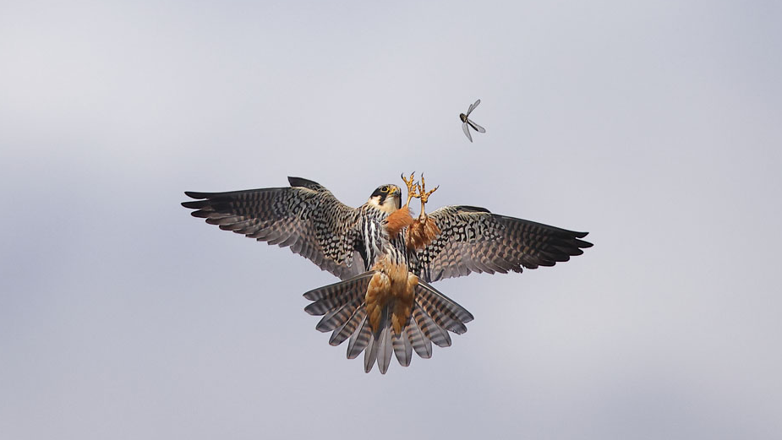
Hobby hunting dragonflies | Swillbrook Nature Reserve, Cirencester, Gloucestershire | by Dave Soons

Slide 30
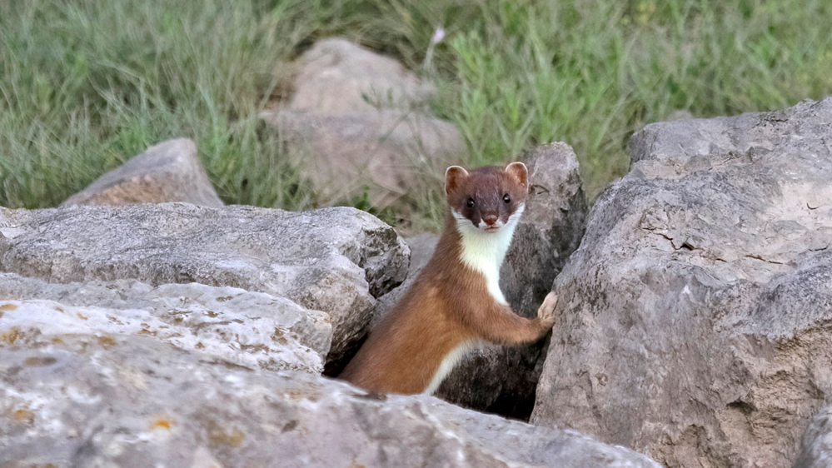
Stoat | (RSPB) Wood Lane Nature Reserve, Ellesmere, Shropshire | by John Hawkins

Slide 31
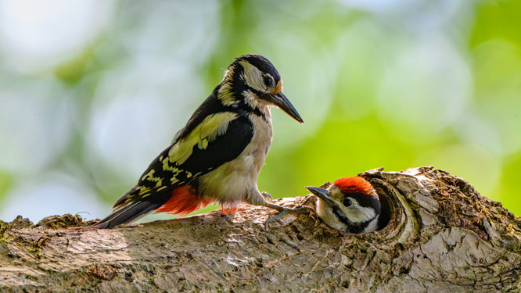
Adult female great spotted woodpecker and nestling | Mullaghglass Quarry, County Antrim, Northern Ireland | by Paul Hilton

Slide 32
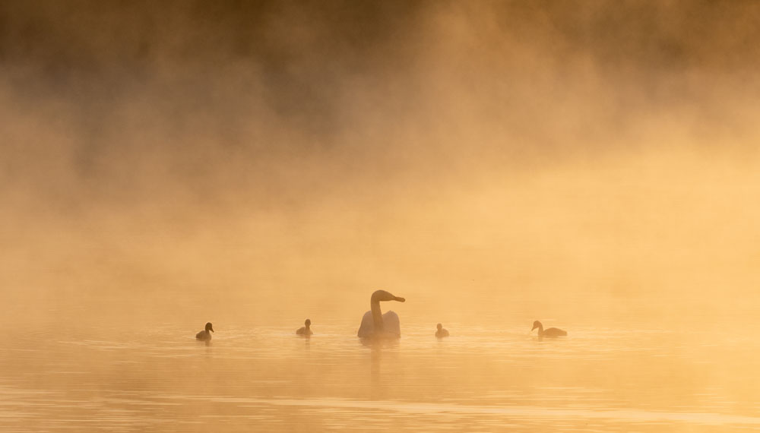
Swan and cygnets | (Cotswold Lakes Trust) Manorbrook Lakes, near Ashton Keynes, Wiltshire | by Jill Bewley

Slide 33
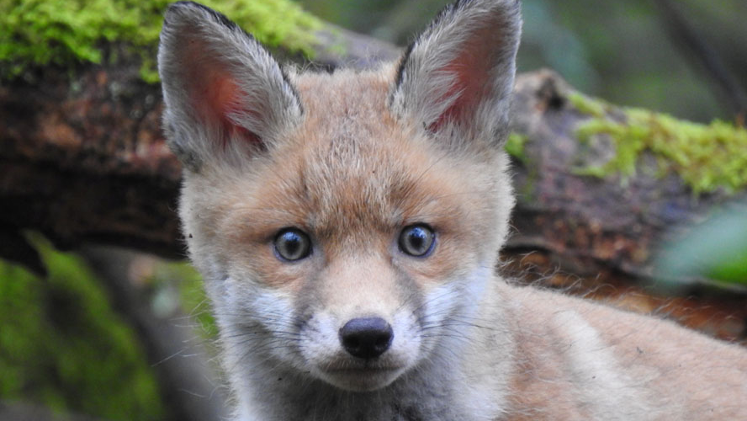
Fox cub | Chard Junction Quarry Nature Reserve, Chard, Somerset | by Dave Helliar

Slide 34
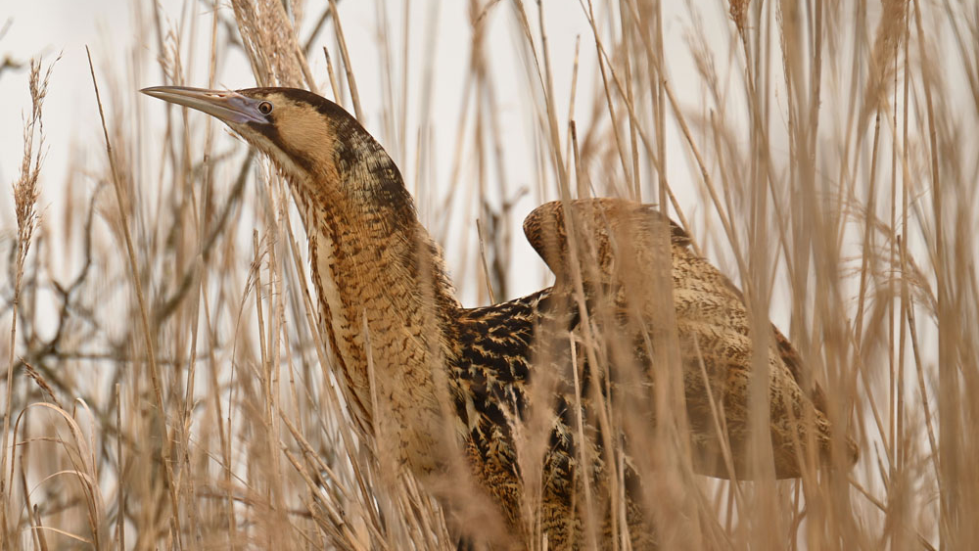
Bittern in reedbed | Kings Dyke Nature Reserve, Whittlesey, Cambridgeshire | by George Walthew

Slide 35
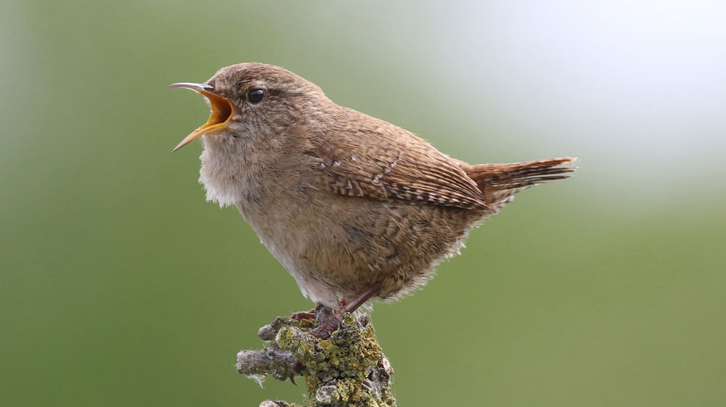
Wren | Croft Quarry, Croft, Leicestershire | by Dick Jones

Slide 36
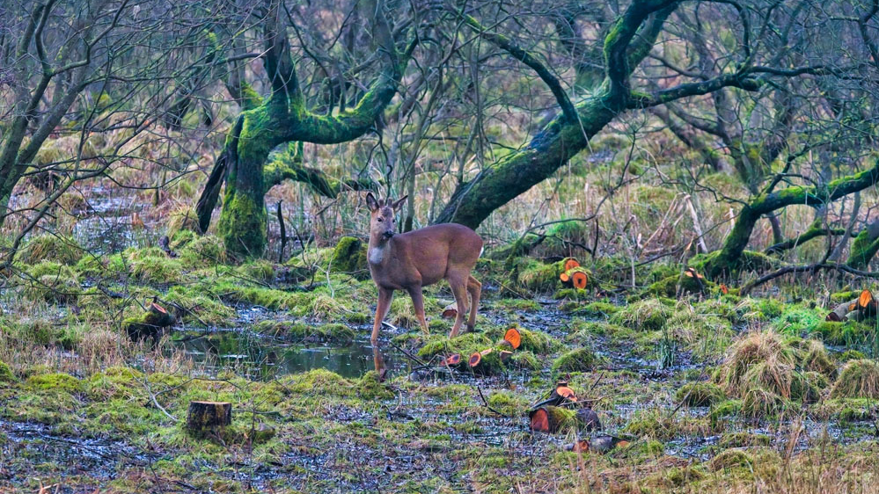
Roe buck in quarry woodland | Swarth Moor which adjoins Dry Rigg Quarry, Helwith Bridge, North Yorkshire | by Michael Cardus

